Slide 1
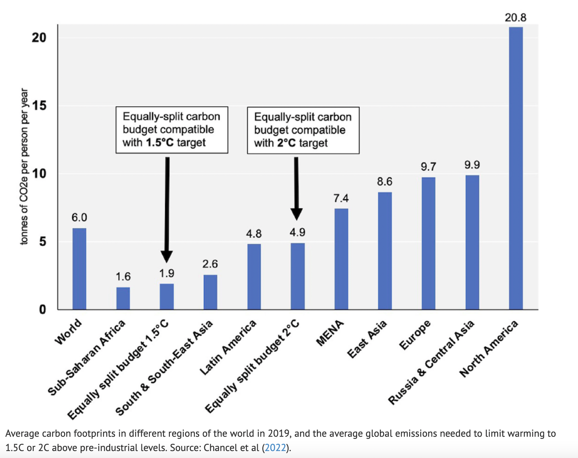
Chancel, 2022: Per-capita budgets needed to avoid 2 degrees warming

Slide 2
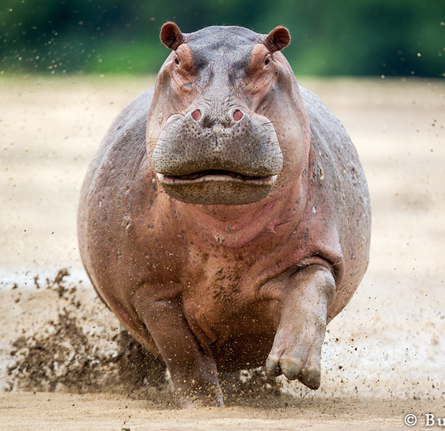
Chancel, 2022: Per-capita budgets needed to avoid 2 degrees warming

Slide 3
Chancel, 2022: Per-capita budgets needed to avoid 2 degrees warming
16 GtC/yr

Slide 4
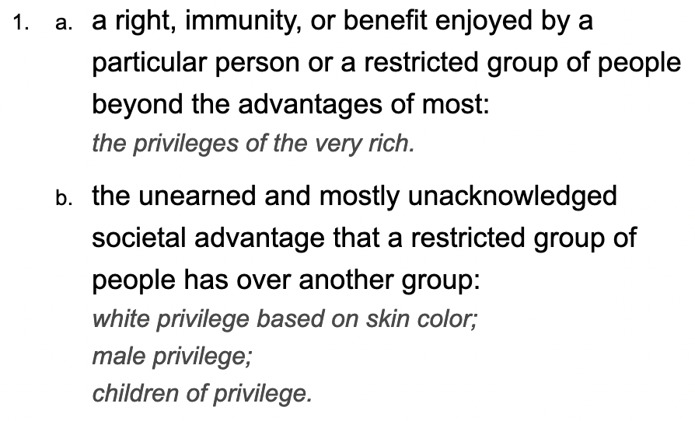
“Carbon Privilege” would seem to be an appropriate term for this
Dictionary.com
My lifetime carbon emissions due to flying.

Slide 5
Chancel, 2022: Per-capita budgets needed to avoid 2 degrees warming
Carbon Privilege = 16 GtC/yr

Slide 6
A “what if I cut back?” perspective on our agency
Cut back on Flying (1/5)
Cut back on driving (1/5)
Eat less beef

Slide 7
An “abolitionist” perspective on our agency
Don’t even like beef
Let’s zoom (1/5)
Why should fly? (1/5)

Slide 8
What’s stopping us from exercising our climate mitigation agency?
Don’t even like beef
Let’s zoom (1/5)
Why should fly? (1/5)
Maybe we don’t know how to talk about it effectively.

Slide 9
Schrepfer’s power analysis method of analyzing of claims
Ask three questions:
How does it function? (Or: What is its goal?)
Who does it benefit?
Where is the power?
Example … in this course …

Slide 10
Rowe’s replacement method for analyzing claims
Explore an idea by replacing one word or concept with another, to see how it sits.
Statement #1:
"It's a waste of time to take individual action to oppose climate change, because it's embedded in the way our economy works; only collective action has any chance of working."

Slide 11
Rowe’s replacement method for analyzing claims
Explore an idea by replacing one word or concept with another, to see how it sits.
Statement #1:
"It's a waste of time to take individual action to oppose climate change, because it's embedded in the way our economy and culture work; only collective action has any chance of working."
Statement #2:
"It's a waste of time to take individual action to oppose white supremacy, because it's embedded in the way our economy and culture work; only collective action has any chance of working."

